Slide 1
Year 3
Miss Furneaux (Bracken)
Mrs Guadagnini (Hogweed)
Mrs Cook
Mrs Franklin
Miss McGill
Mrs Orchard
Mrs Thompson

Slide 2
Year 3
Key Stage 1 to Key Stage 2.
Developing independence.
Continue to develop social skills and friendships.
Maintain high behaviour expectations – positive behaviour policy.
Support children to identify and manage their feelings (Zones of Regulation).

Slide 3
Year 3
Water bottle.
Snacks (am only).
No toys from home or pencil cases please.

Slide 4
English & maths

Slide 5
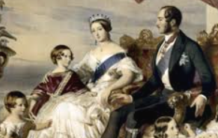
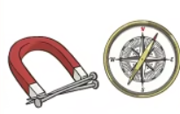
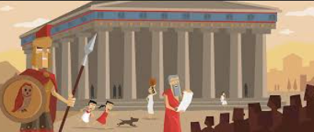
Topics
Victorians (Holdenby House)
Light & Shadows
Ancient Civilisations
Rocks & Soils
Ancient Greece
Nutrition
Forces

Slide 6
Regular days
Library – Mondays
PE – Thursdays & Fridays
Reading Journals – daily
Earrings need to be taken out by the child or not worn at all.
They cannot be covered with tape.

Slide 7
Home learning
Reading Journal
Doodle – Maths, Tables, Spell, English
Doodle – check ‘Assignments’
Time Table Rock Stars

Slide 8
Communication
Home-School Communication Policy
At the door – an appointment, lost jumper etc
Urgent issues need to go via the office.

Slide 9
Questions?

