Slide 1
Meet the Teacher
Year 2:
Frogs Class

Slide 2
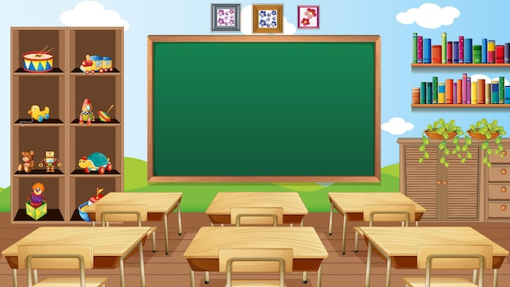
Staff in Year 2
Frogs Class Teacher:
Mrs Wright
Newts Class Teachers:
Mrs Turner
LSAs:
- Mrs Watson, Miss Murgo, Mrs Partridge, Miss McNeil, Mrs Rodgers, Miss Parsons

Slide 3
Topics
On Track
Get Growing
#LoveMK
Fire! Fire!
Amazing Animals
Land Ahoy
https://longmeadow.milton-keynes.sch.uk/curriculum-2/

Slide 4
RWI
Whole school approach to teaching Literacy
Taught by Teachers and LSAs
Groups of 4-30 according to progress
Assessments are carried out half termly

Slide 5
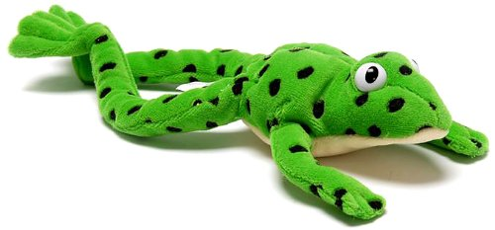
RWI continued
‘Fred Talk, Say the word’
RWI BookBag Books (coloured) for the children to read
Library and picture books to be read by you
Record in reading journal

Slide 6
Reading Journals & RWI Books
In Year 2, we encourage the children to change their own books.
On Fridays, reading journals will be checked and RWI books will be changed during RWI sessions.
50/50 books – children can change these themselves
RWI books not returned will receive a letter home.

Slide 7
PE Days
Outdoor PE : Monday
Indoor PE: Friday
Earrings must be taken out. They cannot have tape over them.

Slide 8
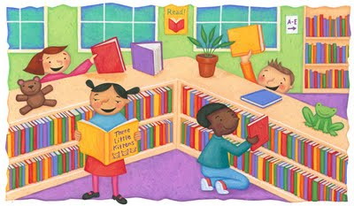
Library
Library will be on Tuesdays – Children cannot borrow a new book until the current one is returned.

Slide 9
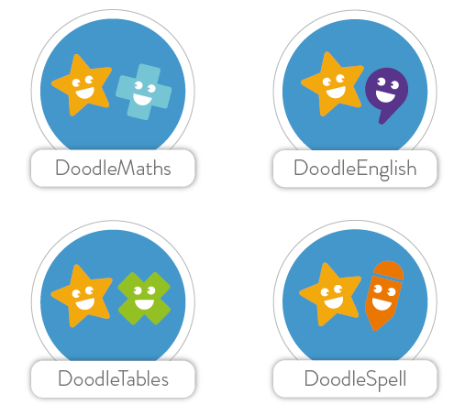
Home Learning
½ Termly Home Learning
Read for 10 mins daily
Doodle (Maths, Tables, Spell and English)/ TTRockstars for 5 mins daily
Remember to check Twitter regularly for updates

